Slide 2
TwinCAT collaboration
An overview
Stolen from Federico rojas

Slide 3


1
The TwinCAT collaboration

Slide 4
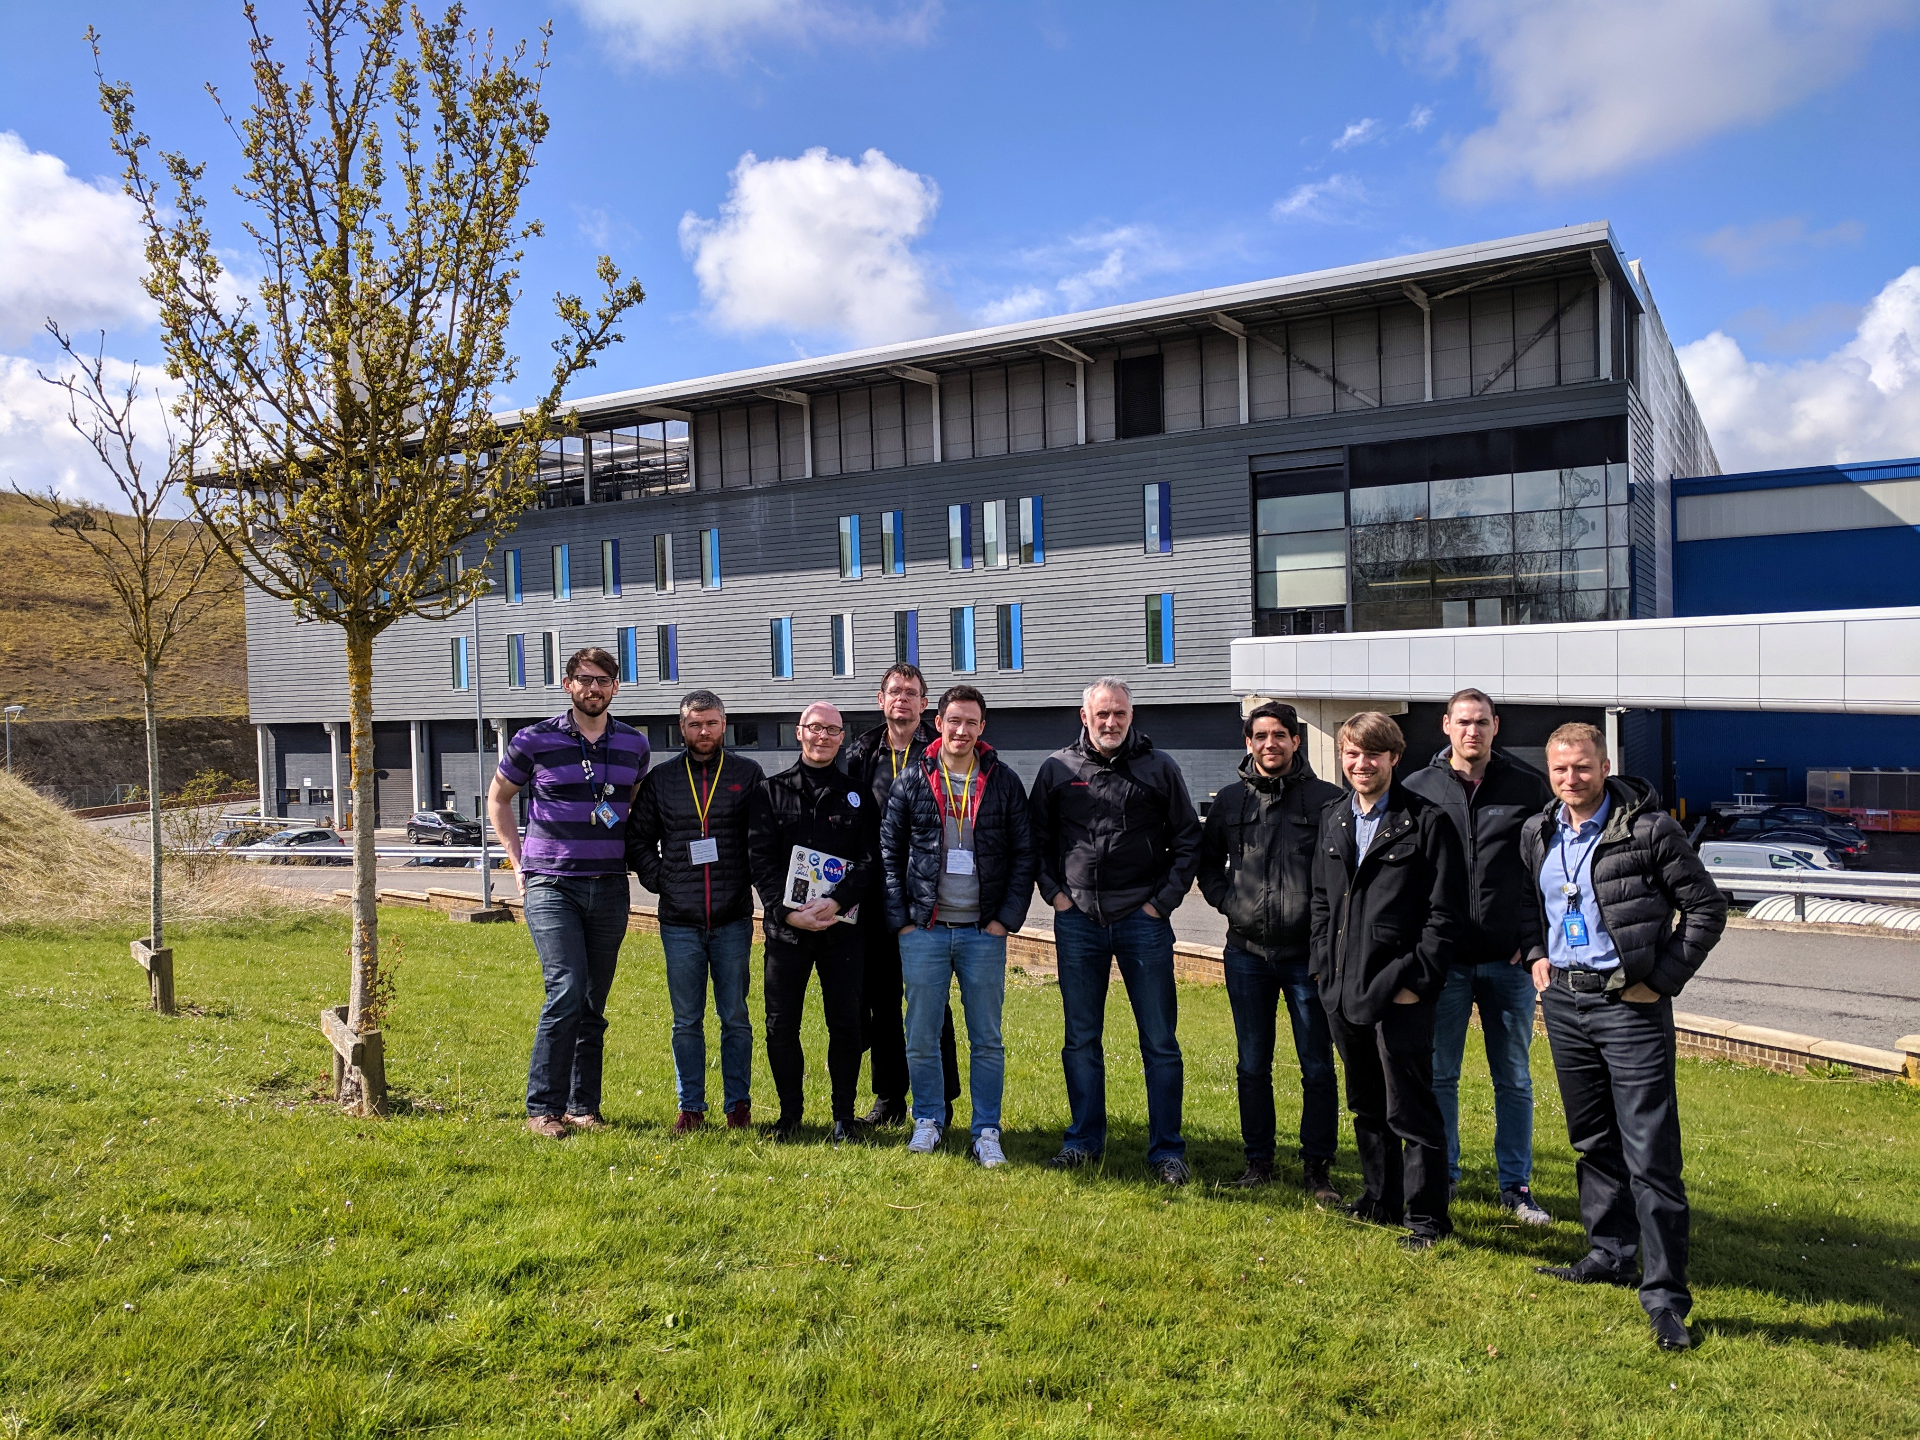
TwinCAT working group
History
4th ESS motion control workshop 2018
TwinCAT day
TwinCAT working group
JCNS
ISIS
ESS
1st Code Camp 2019 (ISIS)
Mission
Purpose
Way of working and processes
Coding standards

Slide 5
TwinCAT working group
Mission
We aim to alleviate the risk associated with introducing a new motion control solution by creating a large group of 'experts' who develop a single software solution and share other internal processes together. The purpose of this group is to encourage collaboration at a wider level between facilities and ensure that other facilities do not make the same mistakes, and suffer from problems, that other groups have already solved.
The working group serves two main purposes:
Collaboratively develop a Beckhoff based PLC software solution for motion control at Large Scale Physics Facilities, currently with a focus on neutron science requirements.
Provide an information repository for designing, deploying, commissioning, installing, and long term support, of Beckhoff motion control systems at Large Scale Physics Facilities. This will take the form of written documentation, software tools, and forum discussion.

Slide 6
TwinCAT working group
Joining Requirements
All facilities are welcome to join the working group under the following guidelines:
If using the working group software solution we ask that you get involved with the development process, review tickets on JIRA, and engage in the weekly video conference when possible.
Openness and collaboration are the foundations of this working group, you should be prepared to share any internally developed processes and software where possible.

Slide 7
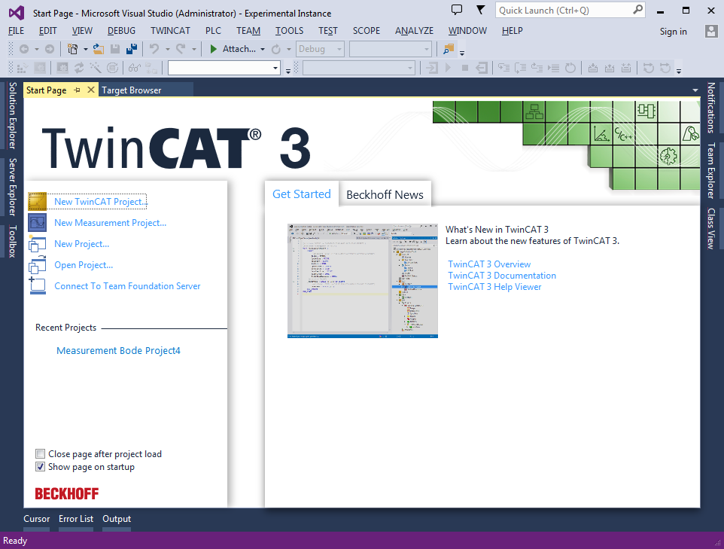
2
TwinCAT generic project

Slide 8
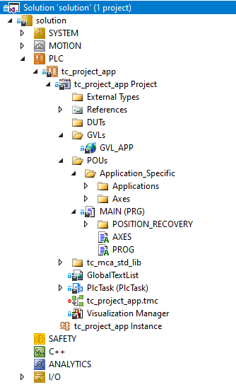
TwinCAT generic project
tc_generic_structure
A generic solution structure for all projects in a Git repository called tc_generic_structure with a submodule called tc_mca_std_lib.
All necessary code to link the Axis’ data structure and function block’s.
Recovery or persistent positioning data.
Space for programming application specific variables, FB’s and PROG’s.

Slide 9
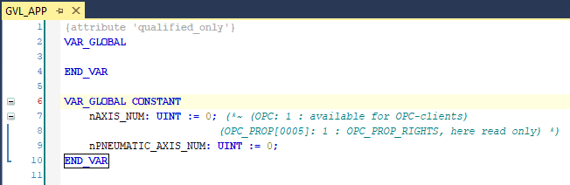
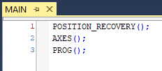
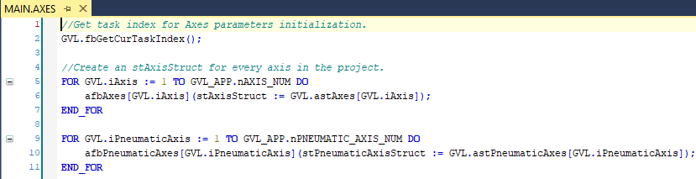
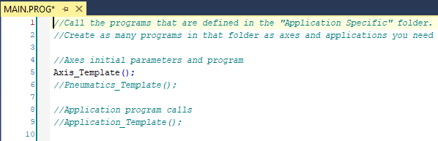
TwinCAT generic project
tc_generic_structure

Slide 10

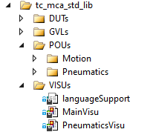
3
TwinCAT MCA standard library

Slide 11
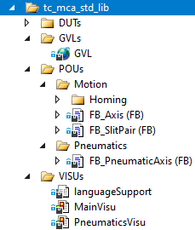
TwinCAT MCA standard library
tc_mca_std_lib
A Git repository as a submodule to tc_generic_structure.
All data structures, function blocks and a GUI for motion applications.
DUTs
POUs
VISUs

Slide 12
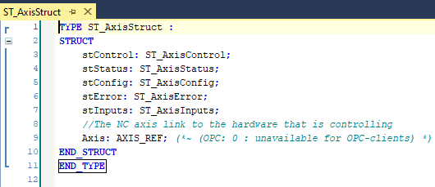
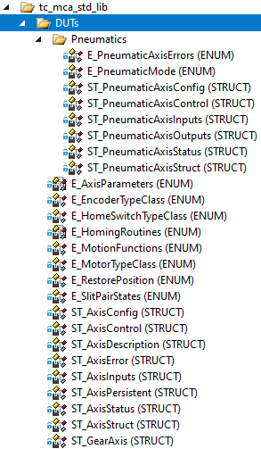
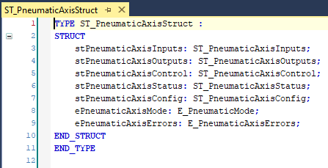
TwinCAT MCA standard library
DUTs: ST_AxisStruct, ST_PneumaticAxisStruct

Slide 13
TwinCAT MCA standard library
ST_AxisStruct
ST_AxisControl: These are parameters that are used to initiate axis movements they are commands that are commonly used.
ST_AxisStatus: NC and FB’s status
ST_AxisConfig: These are axis parameters that are set up during commissioning and in theory don't need to be change as part of daily moving of axes.
ST_AxisError: Error ID’s of the motion FB’s and NC
ST_AxisInputs: physical inputs for limit switches and home sensor
AXIS_REF: The AXIS_REF data type contains axis information. AXIS_REF is an interface between the PLC and the NC.

Slide 14
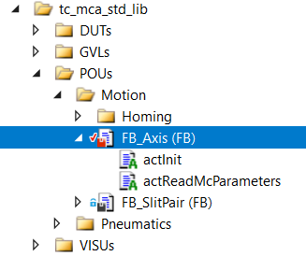
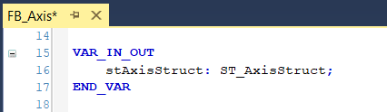
TwinCAT MCA standard library
FB_Axis
VAR_IN_OUT: ST_AxisStruct
Supported functions:
MC_Power
MC_Reset
MC_Stop
MC_Halt
MC_Jog
MC_MoveAbsolute
MC_MoveVelocity
MC_MoveRelative
MC_MoveModulo
MC_GearIn
MC_GearOut
MC_GearInMultiMaster
FB_Homing
MC_WriteParameter
MC_ReadParameter

Slide 15
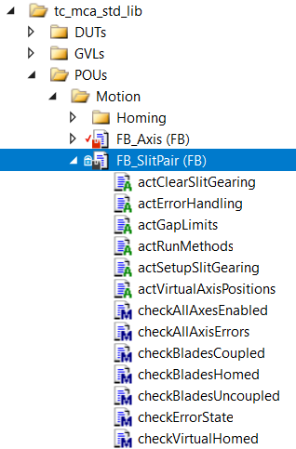
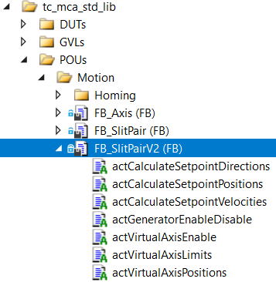
TwinCAT MCA standard library
FB_SlitPair, FB_SlitPairV2
Two real axes: positive and negative blade.
Two virtual axes: gap size and gap center.
Individual control for real axes.
FB_SlitPair
Multi master gearing.
Issue: automatic gear in and out.
FB_SlitPairV2
Set point generator for real and virtual axes.
Issue: lag error in some cases.

Slide 16
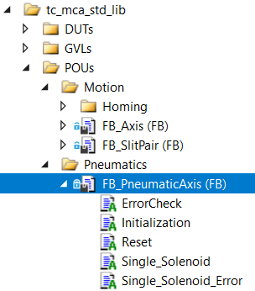
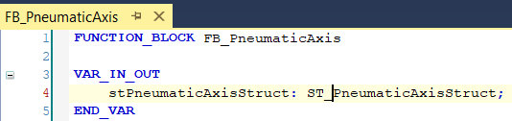
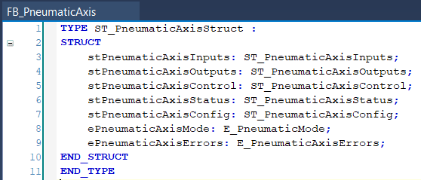
TwinCAT MCA standard library
FB_PneumaticAxis
VAR_IN_OUT: ST_PneumaticAxisStruct
Single solenoid valves
HW and/or SW control
Time out errors and status

Slide 17
Useful Links
https://confluence.esss.lu.se/display/MCAG/TwinCAT+Commissioning+Workflow

Slide 19
References
[1] https://confluence.esss.lu.se/display/MCAG/TwinCAT+Commissioning+Workflow
[2] https://confluence.esss.lu.se/display/MCAG/1-Motors-Feedback-Switches
19
Notes:
Thanks

Slide 20

Questions?

Slide 21
Thank you!

